Slide 1
Data Analysis on SAT/ACT Participation Across 50 states
For College Board
04/05/2018
Kiros G.
www://kirosdsi.com

Slide 2

Fairness Quality Education Matters
How To Enhance Participation Rates for the ACT & SAT College Entrance Examination?

Slide 3

Methodology
Understanding the Data
  Where to Explore /Focus?
  Know each aspect/attribute
Cleaning the Data
  Calculations and Missing Values
Visualizing the data

Slide 4
Procedure.
Opened the CSV data of ACT and SAT in excel and then jupyter notebook

Slide 5
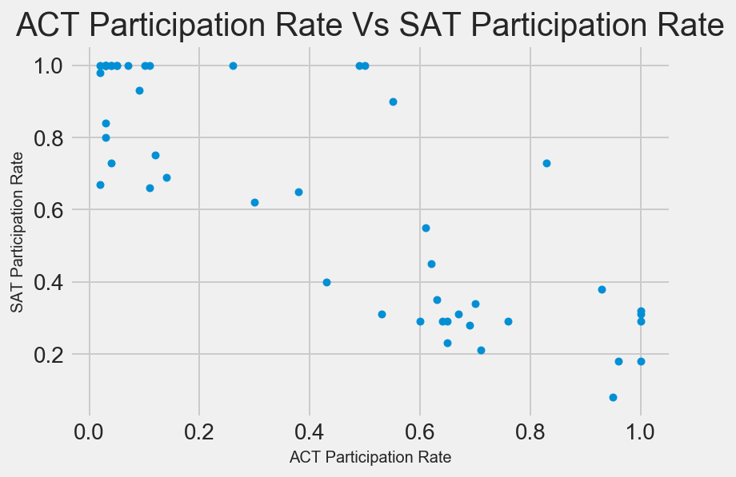
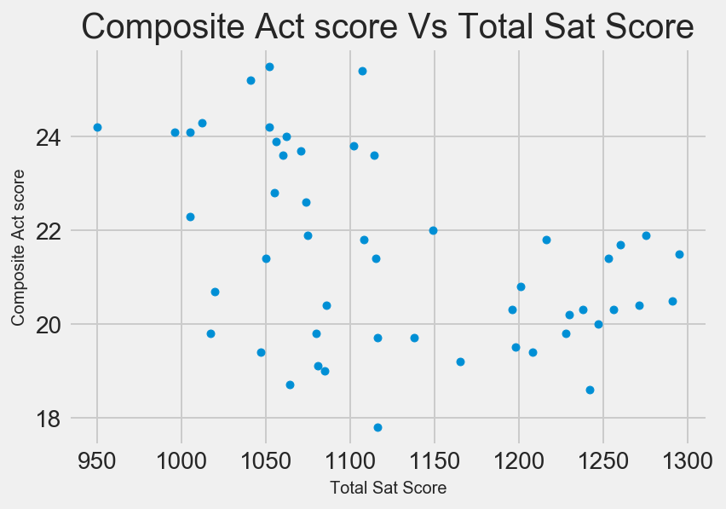
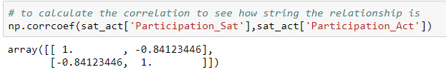
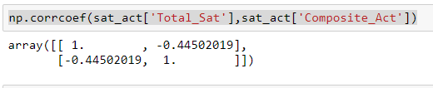
Exam Participation
SAT Examination
ACT Examination

Slide 6
Comaprison
SAT
  3hrs 45 min
  10sections
    3maths
    3 critical reading
    2 writing
    1 easy
    1 experimental
Reading: Sentence completion and passage based reading
Science: None
Easy: required
Score completion: Each section is worth 800 points
Scoring: aggregate of 3 scores 600-2400
Penalities: ¼ of points for wrong answer
ACT
  4 sections
    English, Math,reading section
    Writing section(optional)
4 passaged and 10 questions per passage
Science: problem solving
Math: optional
Score composition: Each section is worth 35 points
Scoring: average of 4 sections 1-36
Penalities: No

Slide 7
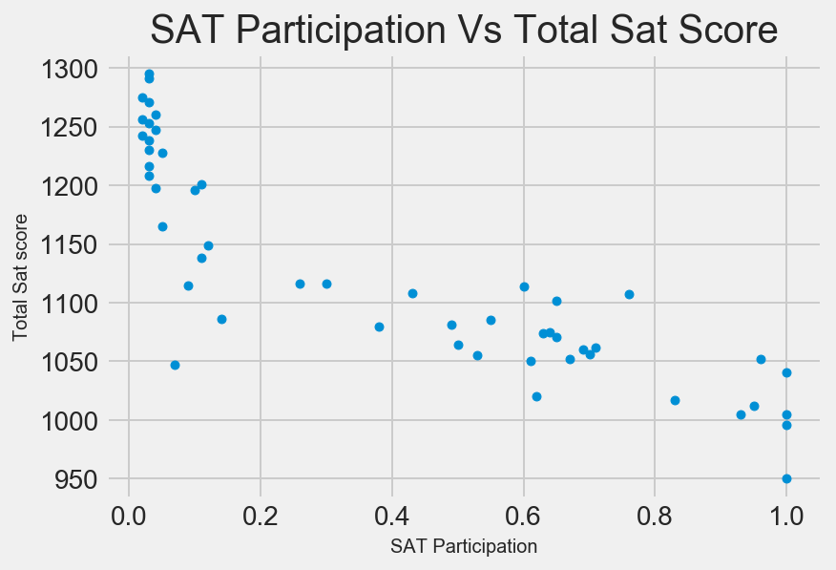
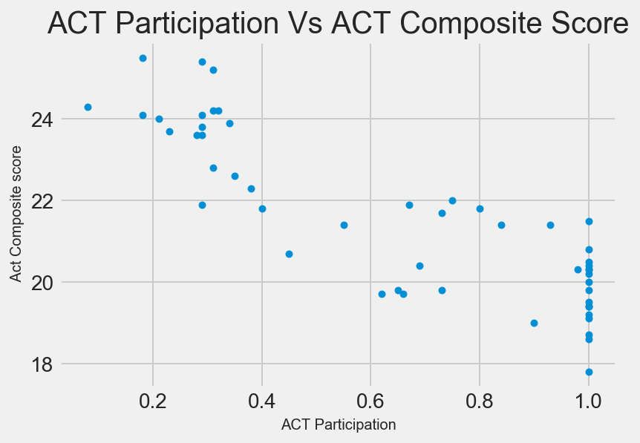

PARTICIPATION

Slide 8
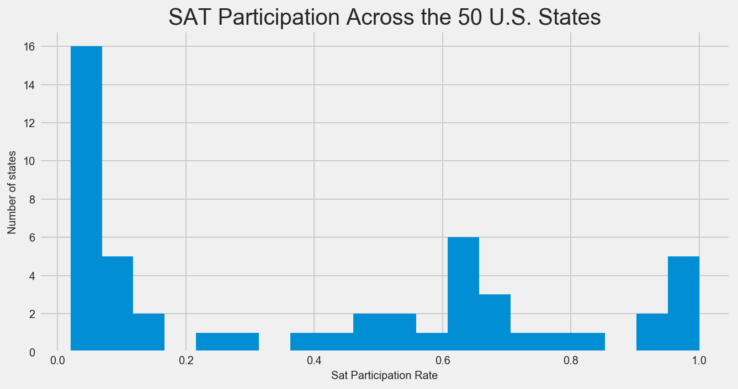
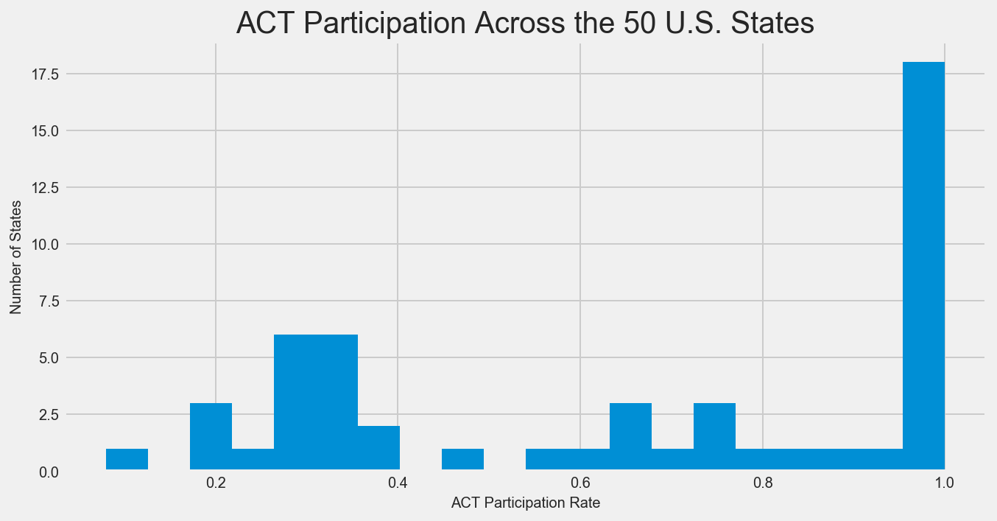
SAT Participation rate
ACT Participation Rate
Mean = Median = 0.405
Std = 0.35
Median = 0.679 > Mean 0.645
Std = 0.35
Notes:
NB: Interesting finding is that in midwestern states where only few schools require SAT, only students willing to take extra challenge in competitive schools would take SAT instead of taking the ACT. From the Data : CA,Texas and East states and the state of illinois or have the highest participation level

Slide 9
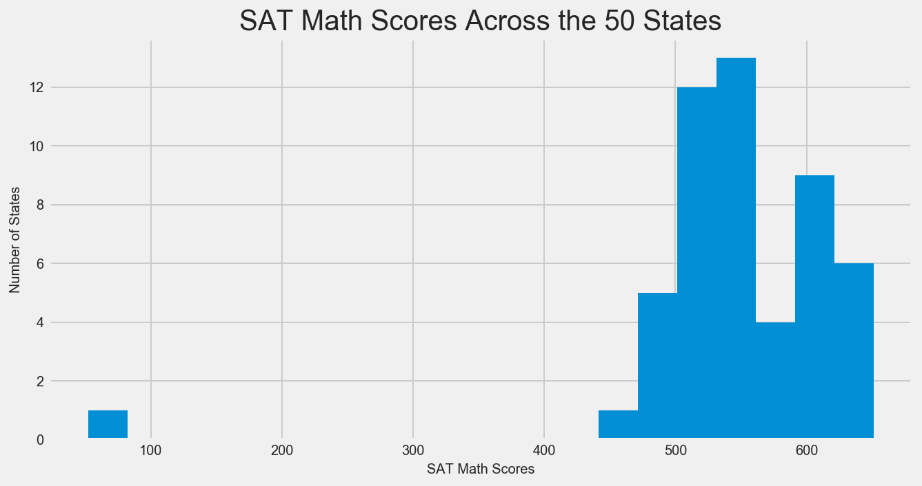
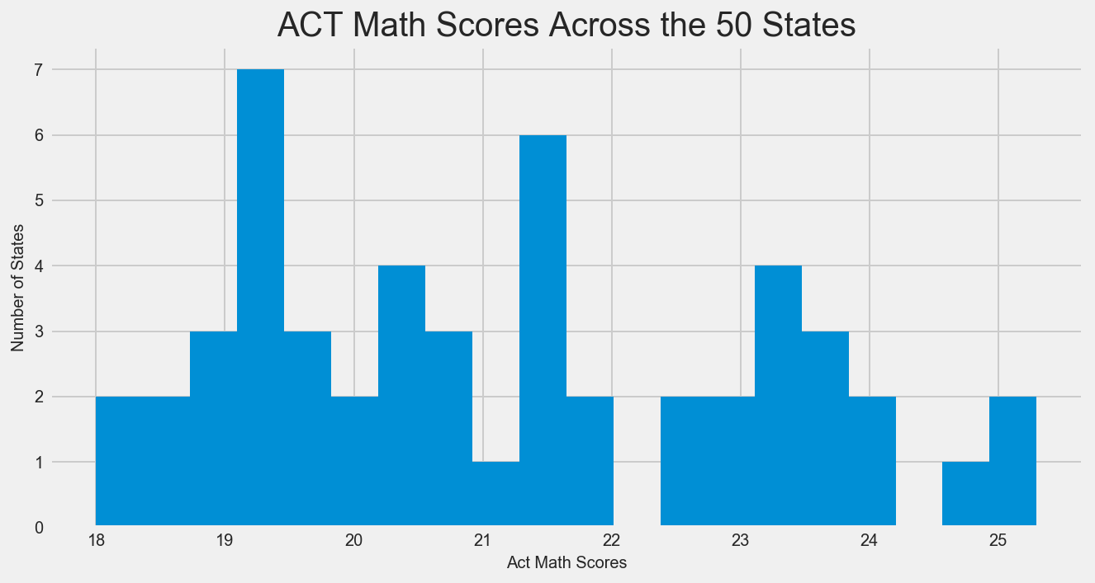

Comparison of SAT Math and ACT Math
Mean =Median = 21 std = 84

Slide 10
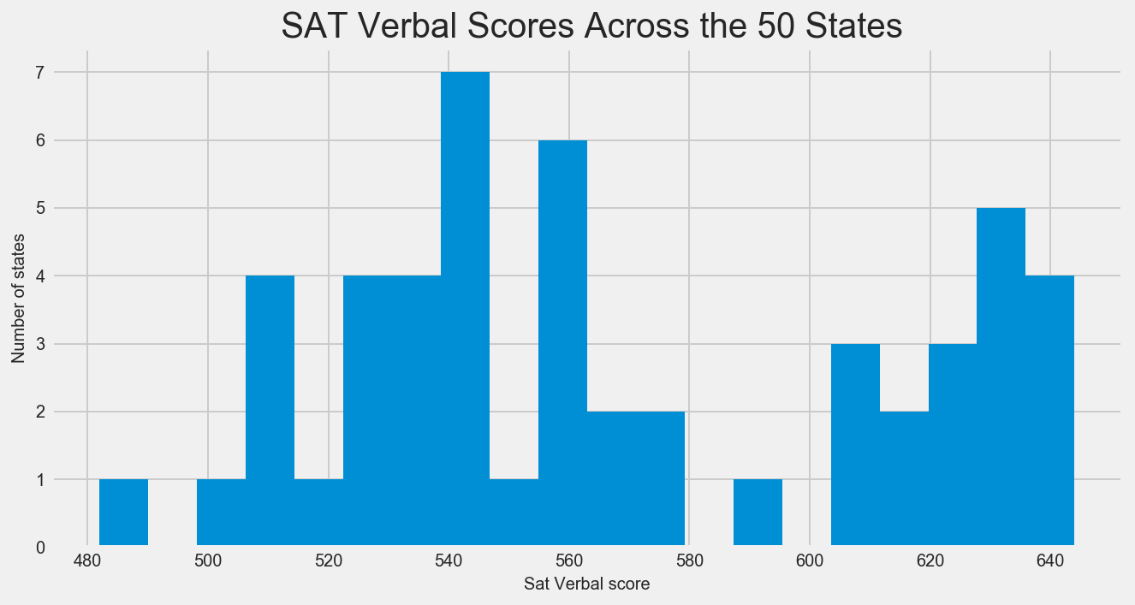
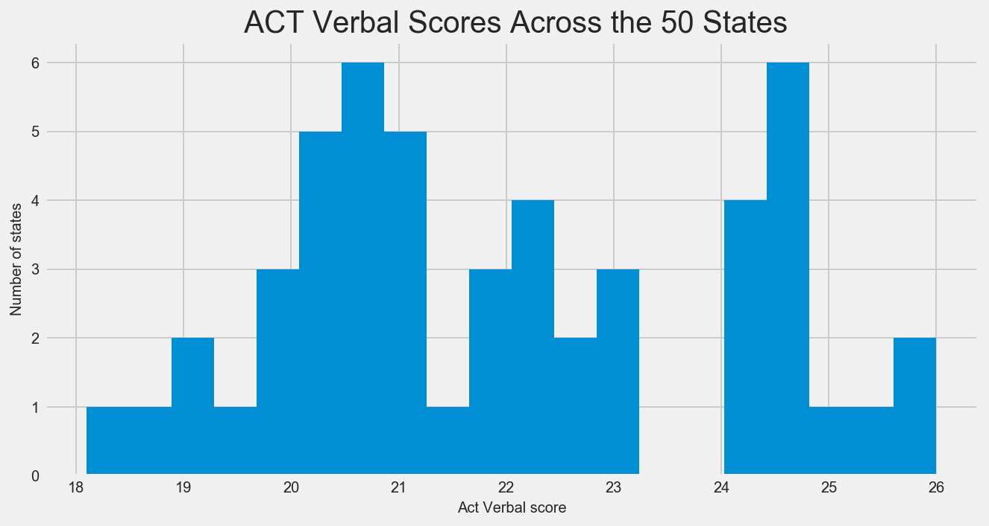

Comparison of Verbal scores
Mean =Median = 21 std = 84

Slide 11
Comparison by State using the SAT and ACT Data elements
Please Follow the Link: https://public.tableau.com/profile/kiros8808#!/vizhome/SATandACTPreliminarycomparisonbyUSStatebyTotalscore/ParticipationbyTotal?publish=yes

Slide 12
Observations
The interesting point is Inferencing
It’s hard to say, as more data is needed, However SAT scores across the US are probably closer to the CLT(aka = Normal Distribution) due to the variance in state population.
The average of the state scores doesn't tell anything

Slide 13
Observations
The more eligible students participate in the test the less average score is
  Interesting finding is that in midwestern states where only few schools require SAT, only students willing to take extra challenge in competitive schools would take SAT instead of taking the ACT.
  From the Data : CA,Texas and East states and the state of illinois or have the highest participation level
No relationship(correlation) between population density of a state with participation

Slide 14
Recommendations
Emphasis/Attention
  High School education and Test Preparation so that students need to take the exam with out adding burden to the family income
    Education budget(local, state and stakeholders)
Data Collection
  Need Average scores for both test scores
  Connecticut scores have the same weight as Texas scores
  Convert scores to % as the SAT/ACT scores are scored differently
  Collect more or include Granular data(school, district, major regions, Demographic)

Slide 15
Recommendations cont’d
What information will correlate with Participation rate and scores in each state
How to mingle down or the information by state
Average score and Family Income?
  Is there any possible Association??

Slide 16
THANK YOU

